Slide 1

MTECH AAI COHORT-1 Dissertation Project – Phase 1
Presented by: Sanjeev Kumar Pandey
Enrolment No: MT23AAI001
Project Guide: Dr. Amit Agrawal

Slide 2

AI/Data-Driven Positioning and Human Activity Recognition
VNIT Nagpur
Sanjeev Kumar Pandey

Slide 3
Introduction
Human Activity Recognition (HAR) aims to automatically identify and classify human actions using sensor data.
Traditional HAR approaches rely on cameras or wearable sensors, which can raise privacy concerns, require user compliance, and may be affected by lighting or obstructions.
Recent advances leverage Wi-Fi Channel State Information (CSI), which captures fine-grained changes in wireless signals caused by human movement, enabling device-free, non-intrusive activity recognition.

Slide 4
Motivation
Privacy & Comfort: CSI-based HAR does not require cameras or wearables, preserving user privacy and comfort in sensitive environments like homes and healthcare facilities.
Ubiquity & Cost-Effectiveness: Utilizes existing Wi-Fi infrastructure, making deployment practical and affordable
Robustness: CSI provides detailed amplitude and phase information, allowing accurate detection of subtle and complex activities even through walls or in low-light conditions.
Research & Real-World Impact: Enables applications such as elderly monitoring, fall detection, smart homes, and security, driving significant interest from both academia and industry.
Technological Advancement: The integration of deep learning with CSI data has demonstrated high accuracy and reliability, opening new frontiers in non-intrusive human sensing

Slide 5

Problem statement
02
Unlocking new horizons

Slide 6
Problem statement
Traditional Human Activity Recognition (HAR) systems often rely on cameras or wearable sensors, which:
Compromise user privacy
Require user compliance and maintenance
Are sensitive to lighting conditions and obstructions
There is a need for a non-intrusive, privacy-preserving, and robust HAR solution that can:
Accurately detect and classify multiple human activities in real-time
Work effectively in diverse indoor environments without requiring users to wear devices or be constantly monitored by cameras
Key Challenge: How can we leverage Wi-Fi Channel State Information (CSI) data to develop an accurate and reliable HAR system that overcomes the limitations of traditional approaches?

Slide 7
Objectives
Develop a HAR system using Wi-Fi CSI data
Accurately classify 10 human activities
Ensure privacy without cameras or wearables
Evaluate performance in real indoor environments
Goal: Deliver a robust, privacy-preserving HAR solution for practical applications.

Slide 8

Literature Review
03
Shortlisting best approach

Slide 9
Research Paper Reference
Wang et al. (2017), "Device-Free Human Activity Recognition Using CSI," IEEE TMC.
Source: https://dl.acm.org/doi/10.1109/jsac.2017.2679658
Kotaru et al. (2015), "SpotFi: Decimeter Level Localization Using WiFi," ACM SIGCOMM.
Source: https://web.stanford.edu/~skatti/pubs/sigcomm15-spotfi.pdf
Yongsen Ma, Gang Zhou, Shuangquan Wang (2019), "WiFi Sensing with Channel State Information: A Survey" IEEE IoT Journal
https://dlnext.acm.org/doi/abs/10.1145/3310194
Zhenyue Gao, Jianqiang Xue, Jianxing Zhang & Wendong Xiao (2022)" Cross-modal meta-learning for WiFi-based human activity recognition," ACM Digital Library
https://dl.acm.org/doi/10.1145/3570361.3615754

Slide 10
Dataset / Research Paper Mapping
CSI Based Datasets
Kaggle CSI Dataset (geninhu/csi-dataset) : https://www.kaggle.com/datasets/geninhu/csi-dataset
UT-HAR : https://github.com/xyanchen/WiFi-CSI-Sensing-Benchmark
Widrar3.0 : https://tns.thss.tsinghua.edu.cn/widar3.0/ https://cswu.me/papers/mobisys19_widar3_paper.pdf
CSI Dataset for Wireless Human Sensing : https://ieee-dataport.org/documents/csi-dataset-wireless-human-sensing-80-mhz-wi-fi-channels
Sensor Based Datasets
UCI HAR : https://archive.ics.uci.edu/ml/datasets/human+activity+recognition+using+smartphones
KU-HAR : https://paperswithcode.com/dataset/ku-har
Human Activity Recognition based on Wi-Fi CSI Data : https://eprints.whiterose.ac.uk/id/eprint/184207/1/1-s2.0-S1877050921024509-main.pdf

Slide 11
Datasets
CSI Based Dataset
Dataset Name | Description
Kaggle CSI Dataset (geninhu/csi-dataset) | Wi-Fi Channel State Information (CSI) data for HAR. Contains raw CSI measurements suitable for activity recognition and wireless sensing research. 10 distinct human activities by 30 Participants
UT-HAR | Wi-Fi CSI data, 6 activities, 30 participants, 2.4/5 GHz bands.
Widar3.0 | CSI for 25 activities, 3D motion tracking.
CSI Dataset for Wireless Human Sensing | 7 activities, 10 people, 7 environments, 80 MHz Wi-Fi, 13+ hours of CSI data
Sensor Based Dataset
Dataset Name | Description
UCI HAR | Smartphone accelerometer/gyroscope, 6 activities.
KU-HAR | 18 activities, 90 participants, wearable sensors.

Slide 12
CSI Based Dataset
This dataset is providing rich, fine-grained wireless signal data, making it ideal for developing robust and accurate HAR models, especially in indoor environments where privacy and unobtrusiveness are important.
Source URL | https://www.kaggle.com/datasets/geninhu/csi-dataset
Type | Wi-Fi Channel State Information (CSI) data for Human Activity Recognition (HAR)
Number of Activity Classes | 10 distinct human activities [ 'falling_down_from_sitting_position' 'falling_down_from_standing_position' 'lying' 'pick_a_pen_from_the_ground' 'sitting' 'sitting_down' 'stand_still' 'standing up' 'turning' 'walking’ ]
Data Format | Training and evaluating machine learning models for activity recognition and wireless sensing research
Data Size | 1 directory, 30 files (as per Kaggle listing)
Applications | Non-intrusive, privacy-preserving activity recognition

Slide 13

Proposed Methodology
04
Executive Team and Key Departments

Slide 14
Data Acquisition & Preprocessing
Collect raw Wi-Fi CSI data for 10 activities.
Denoise and normalize signals; apply Mixup augmentation.
Hybrid Deep Learning Model
ResNet-1D for spatial feature extraction.
BiLSTM for temporal sequence modelling.
Attention layer to focus on key time steps.
Hybrid feature extraction strategy:
Signal preprocessing (filtering, PCA) to enhance raw CSI data.
ResNet-1D for spatial/local feature learning.
BiLSTM + Attention for temporal modeling and focus.
Mixup for robustness against overfitting.
Training & Validation
5-fold cross-validation for robustness.
AdamW optimizer, cosine learning rate decay, dropout regularization.
Evaluation
Assess with accuracy, F1-score, and confusion matrix.
Visualize results and class distributions.

Slide 15
Novelty and Innovation
Hybrid Model: Combines ResNet-1D, BiLSTM, and Attention for robust spatial-temporal feature extraction from CSI data.
Device-Free & Privacy-Preserving: Uses Wi-Fi signals-no cameras or wearables required.
Advanced Augmentation: Mixup technique improves generalization and performance.
Real-World Evaluation: Validated on diverse, unconstrained indoor activity data.
Delivers accurate, privacy-focused HAR using cutting-edge deep learning and wireless sensing.

Slide 16
System Architecture Diagram
Model Training and Validation
Data Loading
Pre-processing
Model Creation
Training with K-Fold Validation
Evaluation
End
Visualization (Plots)

Slide 17
Data Loading
Load NPZ Files
End
Concatenate Subjects
Pre-processing
Label Encoding
Reshape Data
Stratified Train / Val / Test Split
End
Model Architecture
ResNet-1D Block
Bidirectional LSTM
Attention Mechanism
Global Pooling
Dense Classification
End

Slide 18
Training with K-Fold Validation
Training
K-Fold Cross Validation
Mixup Augmentation
Cosine LR Scheduling
Checkpointing
Save Best Model
End
Evaluation
Test Set Metrics
Class Distribution
End
Confusion Metrics
Visualization
Accuracy/Loss Curves
Feature Analysis
Model Weights
End

Slide 19
Real Time Inference
Load Config
Find Best Model
Load Best Model
Load Test / Real Data
Process Each Sample
Pre-process Sample
Pre-process Sample
Predict Activity
Display Result (True vs Predicted)
Check correctness and Delay
Compute Final Accuracy
End Inference

Slide 20
Implementation Plan and Timeline
04

Slide 21
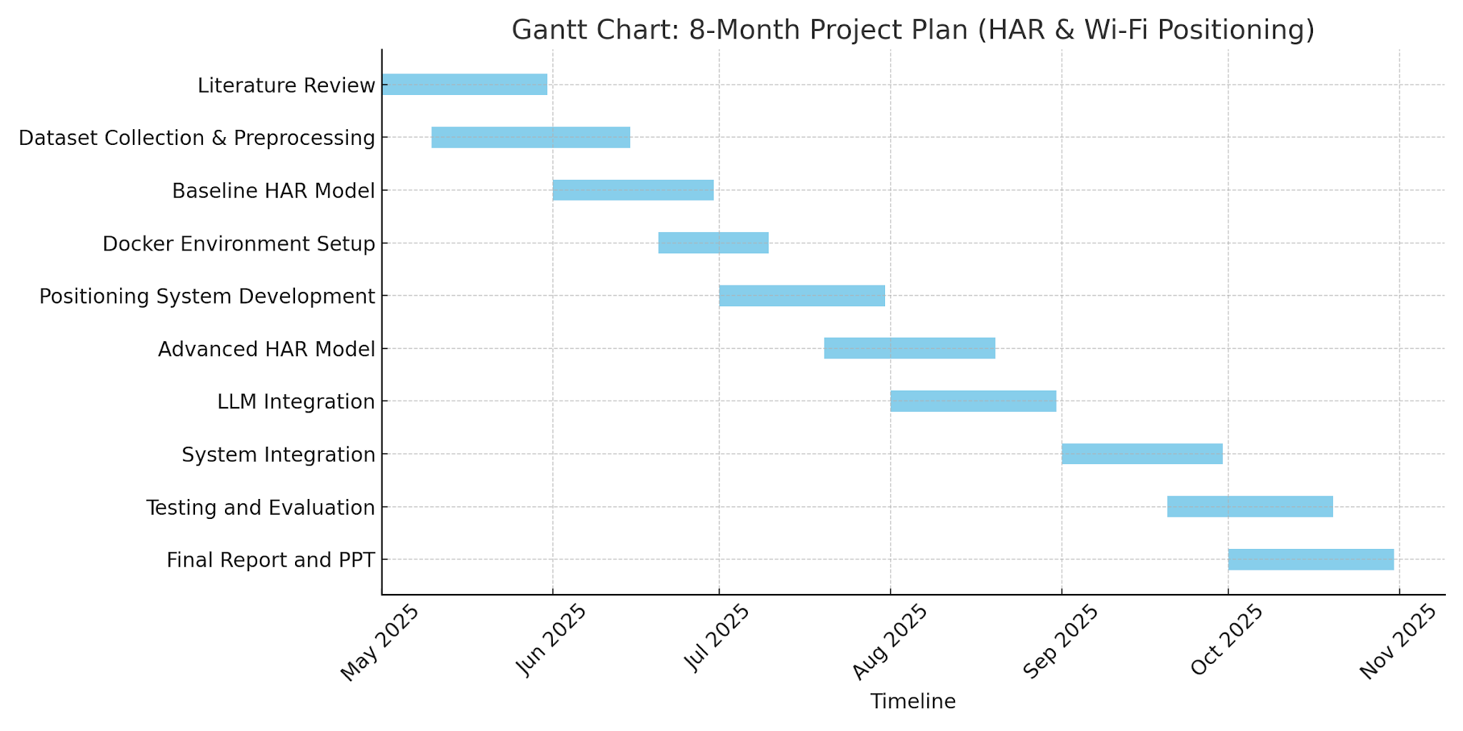

Slide 22

Basic Model Training and Experiment Stats

Slide 23
CSI Dataset Model Training Experiment
Experiment# | Dataset Range | Total Data Volume | Learning Rate | Batch Size | Folds | Epochs per Fold | Minutes/Epoch | Training Status | Loss | Accuracy
1 | 10 | 3682010 (3.68 M) | 0.0003 | 64 | 2 | 20 | 23 | Completed | 0.1946 | 0.9229
2 | 10 | 3682010 (3.68 M) | 0.0024 | 512 | 2 | 1 | 17 | Completed | 1.0953 | 0.8251
3 | 30 | 10978318 (10.97 M) | 0.0024 | 512 | 5 | 30 | 47 | Terminated | 0.6937 | 0.7110
4 | 30 | 10978318 (10.97 M) | 0.0048 | 1024 | 2 | 10 | 41 | Completed | 0.4256 | 0.8260
5 | 15 | 3682010 (3.68 M) | 0.0005 | 64 | 2 | 20 | 35 | Completed | 0.2194 | 0.9126

Slide 24
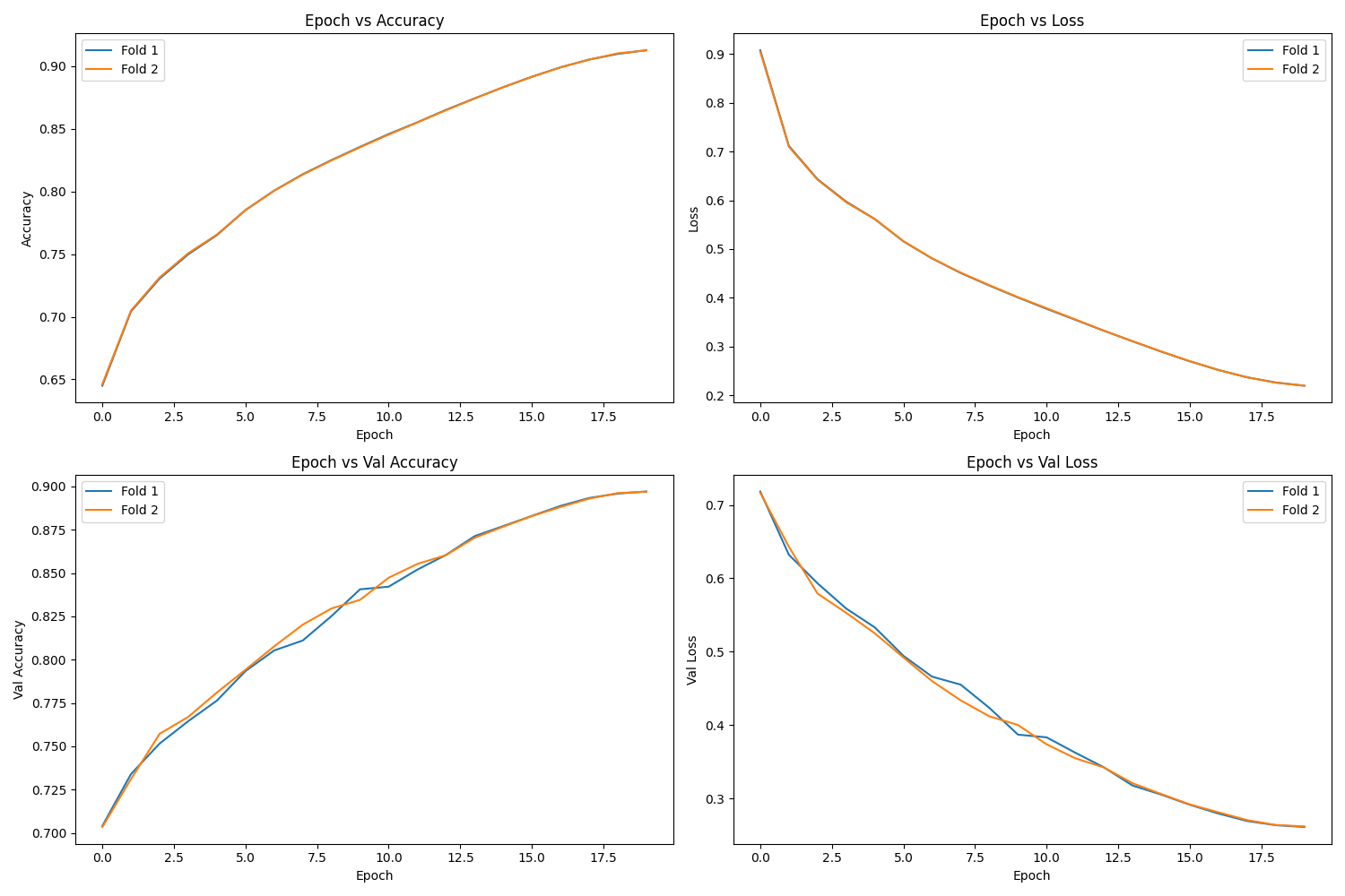

Slide 25

Expected Outcomes
Comprehensive HAR Dataset:
Curated and preprocessed Wi-Fi CSI data covering 10 activities for robust model training and evaluation.
01
Baseline & Advanced HAR Models:
Implementation of both baseline and hybrid deep learning models (ResNet-1D + BiLSTM + Attention) for activity recognition.
02
High Activity Recognition Accuracy:
03
Achieve strong classification metrics (accuracy, F1-score) across multiple activities and environments.
03
Integrated System Prototype:
04
End-to-end HAR and positioning system, deployable in real-world indoor scenarios.
Extensive Evaluation & Visualization:
The project will deliver a validated, privacy-preserving HAR solution with reproducible results and practical deployment potential.
04
Detailed performance analysis, confusion matrices, and class distribution insights.
Final Deliverables:
Complete technical report, project documentation, and presentation summarizing findings and system performance.

Slide 26
Scope for Future Work (Next Semester)
Deploy real-time HAR system on edge/IoT devices
Expand to multi-user and multi-room environments
Add more activity classes for finer recognition
Optimize model for faster, lightweight inference
Explore multimodal fusion with other sensors
Focus: Transition from research to practical, scalable deployment.

Slide 27
Thank You

